Slide 1
Secure Data Hiding in images using steganography
CAPSTONE PROJECT
Presented By
Student Name : Dinesh Baghel
College Name : Inderprastha Engineering College
Department : Computer Science & Engineering

Slide 2
OUTLINE
Problem Statement
Technology used
Wow factor
End users
Result
Conclusion
Git-hub Link
Future scope

Slide 3
Problem Statement
Develop a Python program to securely embed a secret message into an image file (encryption) and later retrieve the hidden message (decryption). The program should utilize the OpenCV library for image manipulation and ensure the integrity and confidentiality of the message through the use of a passcode. The solution must be cross-platform compatible, allowing for efficient encryption and decryption processes.

Slide 4
Technology used
Programming Language : Python
Libraries : OpenCV (cv2) for image processing, OS for file Handling
Algorithm : Custom Encryption Algorithm, Custom Decryption Algorithm
Platform : Cross – Platform Compatibility
Output Format : Encrypted image (JPG) with hidden message

Slide 5
Wow factors
Invisible Encryption: Hides messages within images without altering their visible appearance.
Dual Security: Uses both steganography and password protection for enhanced security.
Lightweight & Fast: Minimal processing time with no need for large encryption keys
Easy & Accessible: Works on any standard image, making secret communication effortless.
No Suspicion: Unlike traditional encryption, it doesn't attract attention or look suspicious.

Slide 6
End users
Cybersecurity Professionals - For secure and discreet communication.
Journalists & Activists - To share sensitive information without detection.
Government & Military - For communication and intelligence sharing.
Businesses & Corporations - To protect confidential data from competitors.
General Users - Anyone needing a private and secure way to exchange messages.

Slide 7
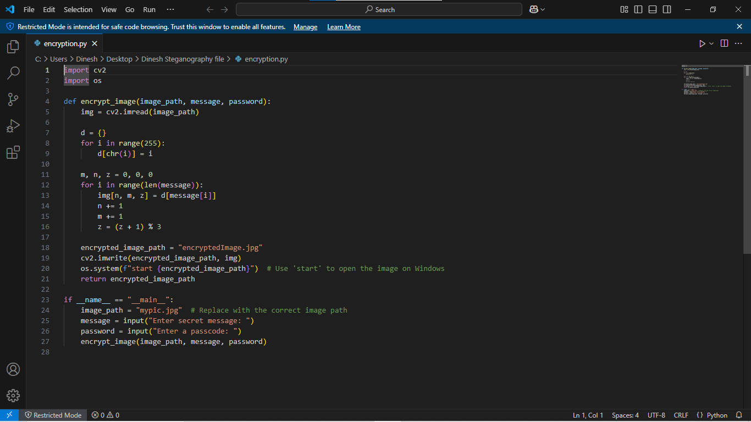
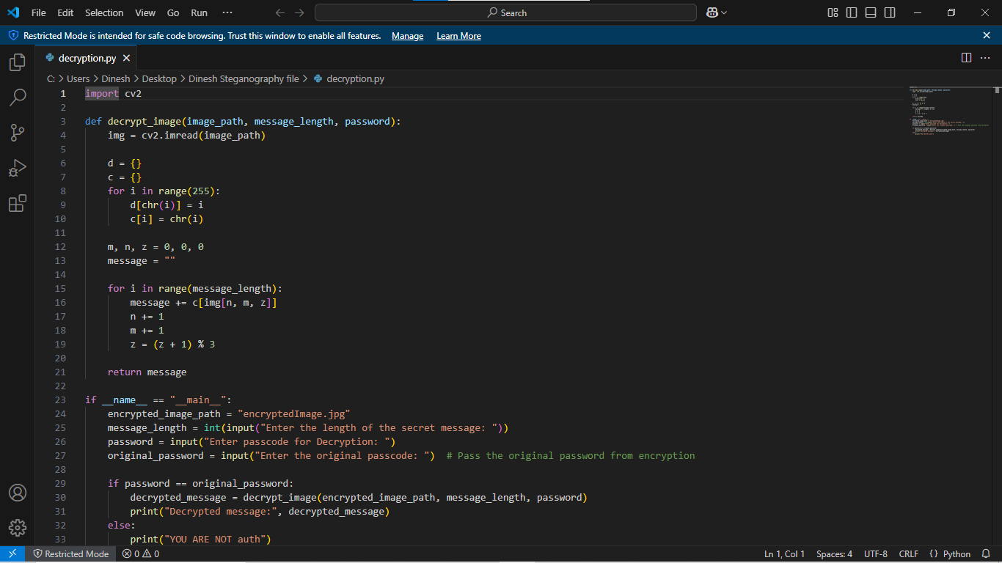
Results

Slide 8
Conclusion
In an era where data security is a major concern. this project presents an innovative and discreet method for secure communication- By leveraging image steganography with Least Significant Bit (LSB) encoding, it allows users to hide messages within images without altering their visual appearance_ Unlike traditional encryption methods, this approach ensures that sensitive information remains unnoticed, reducing the risk of interception.
Additionally. password protection enhances security. ensuring only authorized users can decrypt the hidden message. This technique is highly useful for cybersecurity professionals, journalists, businesses, and individuals who require a safe, efficient, and undetectable way to share confidential data.

Slide 9
GitHub Link
https://github.com/Dinesh01234/Steganography-project.git

Slide 10
Future scope(optional)
Enhanced Encryption: Integrate stronger encryption algorithms along with steganography for added security
Multiple File Formats: Expand support to hide messages in audio, video, and document files.
A1-Based Detection Prevention: Implement A1 techniques to make hidden messages even more undetectable.
Cloud & Mobile Integration: Develop a web or mobile app for easy and secure message hiding and retrieval.
Increased Storage Capacity: Optimize algorithms to store larger messages without affecting image quality.

Slide 11
THANK YOU

